Slide 1
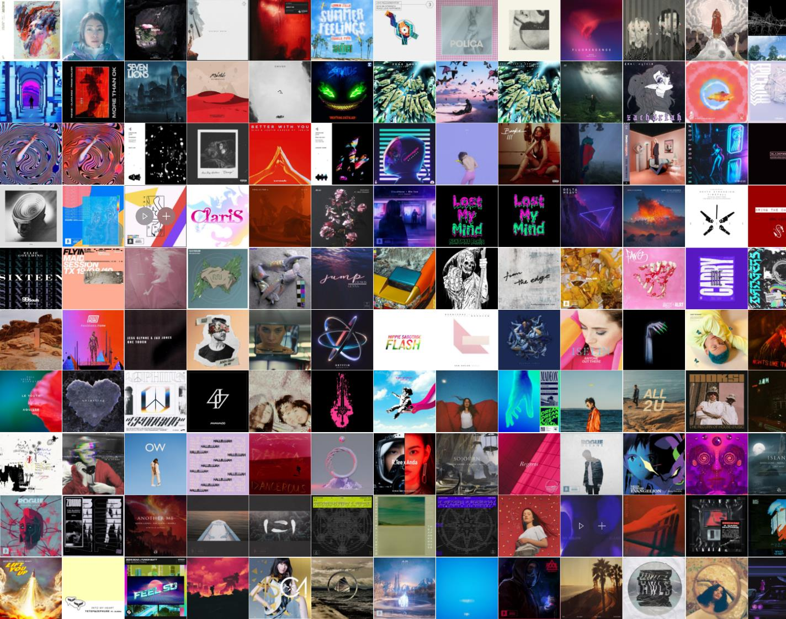
Pre-screening Playlists Using Classification
Lawson Ho

Slide 2

Overview
Background Info
Data Framework
Methodology
Results
Conclusion

Slide 3

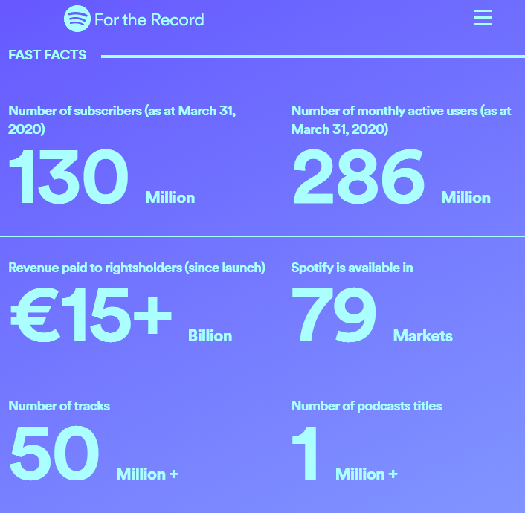
Background Info
Streaming services provide instant access to large libraries
Spotify:
130 million subscribers
50 million tracks available
Need a way to bring up relevant results to users

Slide 4

Objective
Build a classifier based on saved songs to filter playlists.
Use underlying audio features from the Spotify API.

Slide 5
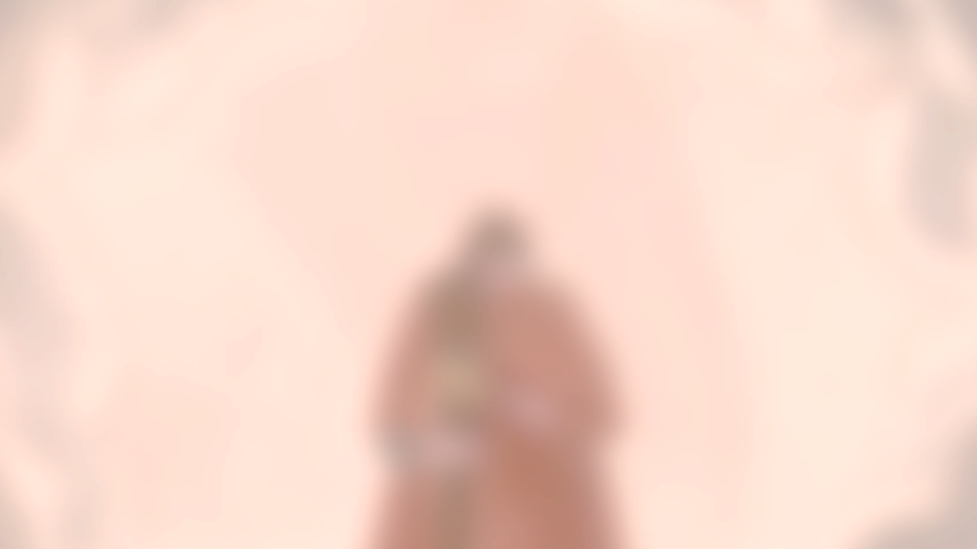
Music Tastes
 | TITLE | ARTIST
🖤 | Montreal (feat. Kimbra) | What So Not, Kimbra
🖤 | Closure – Oriental Cravings Remix | SLUMBERJACK, Ekali, Oriental Cravings
🖤 | Kiss of Death | Rezz, Deathpact
🖤 | Underloved – Cecil | ShockOne, Cecil
🖤 | Asido | Purity Ring
🖤 | Whisper | Boombox Cartel, Nevve
🖤 | D.A.N.C.E. x FIRE x Safe and Sound (WWW) | Justice
🖤 | Star Crossed | 3LAU, VERITE
🖤 | One Out Of Two – feat. Irfrane | Breakbot, Irfrane
🖤 | I Know A Place | MUNA
🖤 | Weathered | Jack Garratt
🖤 | Bravado | Lorde
🖤 | Fall On Me | Louis Futon, BXRBER
🖤 | Girl Front | LOOΠΔ / ODD EYE CIRCLE
Synthetic/electronic sounds
Distinct vocals
Vocals that are not sappy
A splash of K-Pop

Slide 6







Data Framework
SP.PLAYLISTS(ME)
>>>
SP.TRACK(TRACK_ID)
>>>
TITLE | ARTIST
Montreal (feat. Kimbra) | What So Not, Kimbra
Closure – Oriental Cravings Remix | SLUMBERJACK, Ekali, Oriental Cravings
Fading Out (feat. Rromarin) | Mazde, Rromarin
Kiss of Death | Rezz, Deathpact
Underloved – Cecil | ShockOne, Cecil
TRK_ID | TITLE | ARTIST | ALBUM
6ylRKDPOe… | Montreal (feat. Kimbra) | What So Not, Kimbra | Divide & Conquer
3PdFzNNYp… | Closure – Oriental Cravings Remix | SLUMBERJACK, Ekali, Oriental Cravings | SARAWAK (The Remixes)
27AljPd43C… | Fading Out (feat. Rromarin) | Mazde, Rromarin | Fading Out (feat. Rromarin)
7HKkIZzHU… | Kiss of Death | Rezz, Deathpact | Kiss of Death
49mrGrTO… | Underloved – Cecil | ShockOne, Cecil | A Dark Machine
SP.SEARCH(TITLE, ARTIST)
>>>
SP.AUDIO_FEATURES(TRACK_ID)
>>>
TRACK ID
6ylRKDPOe41x4Gi8c00ulP
3PdFzNNYpFUSxjtyCp3igD
27AljPd43CqSWA6WptHyIn
7HKkIZzHUhBXX7SWKUXmod
49mrGrTON4QYZri9gEHSFl
TRK_ID | ACOU | DANC | ENER | INST | LIVE | LOUD | TEMP
6ylRKDPOe… | 0.0705 | 0.528 | 0.935 | 0 | 0.326 | -1.114 | 152.059
3PdFzNNYp… | 0.111 | 0.454 | 0.903 | 1.50E-06 | 0.227 | -3.485 | 181.543
27AljPd43C… | 0.00217 | 0.386 | 0.915 | 0.00033 | 0.361 | -4.885 | 157.021
7HKkIZzHU… | 0.00687 | 0.765 | 0.954 | 0.135 | 0.348 | -1.541 | 130.04
49mrGrTO… | 0.0499 | 0.533 | 0.888 | 1.50E-06 | 0.114 | -2.8 | 150.086

Slide 7

Features
 | ID | Duration
Instrumentalness | Acousticness | Key | Tempo
Liveness | Energy | Valence | Danceability
Speechiness | Loudness | Mode | Time Signature

Slide 8

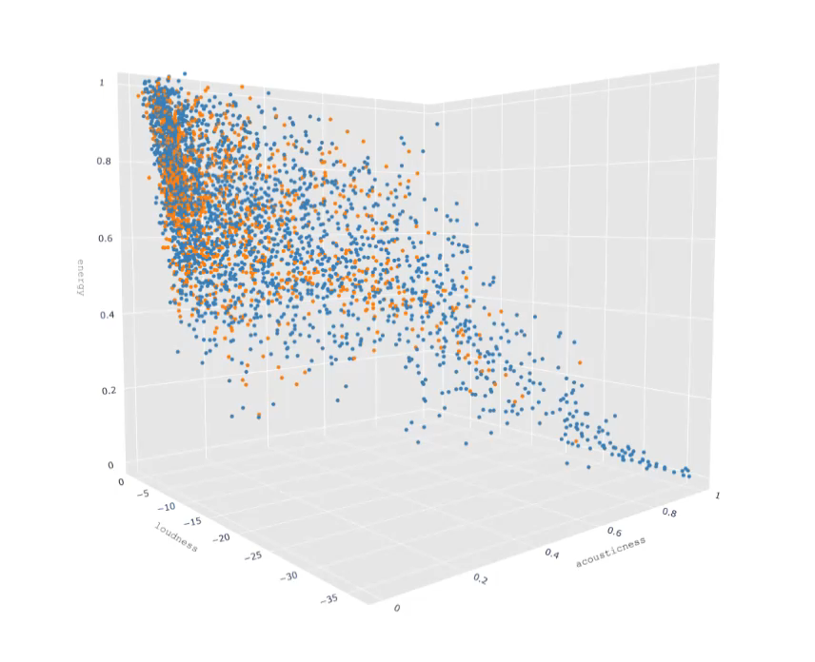
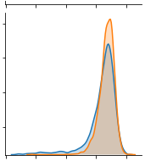
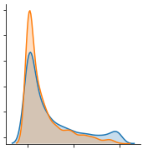
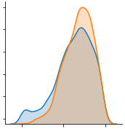
Pair Plot Features
Loudness
 | mean | variance
dislike | 0.772 | 0.015
like | 0.806 | 0.004
Acousticness
 | mean | variance
dislike | 0.249 | 0.087
like | 0.179 | 0.049
Energy
 | mean | variance
dislike | 0.629 | 0.049
like | 0.678 | 0.029

Slide 9

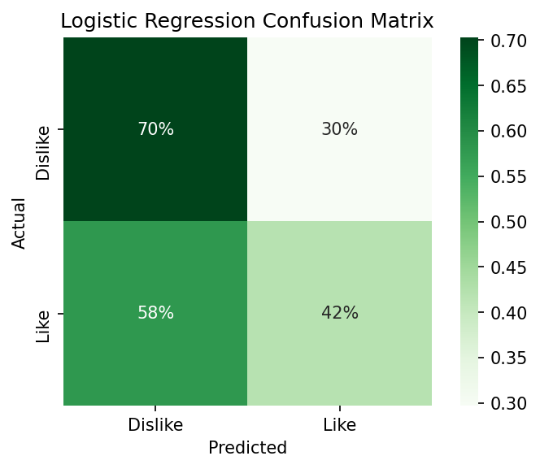
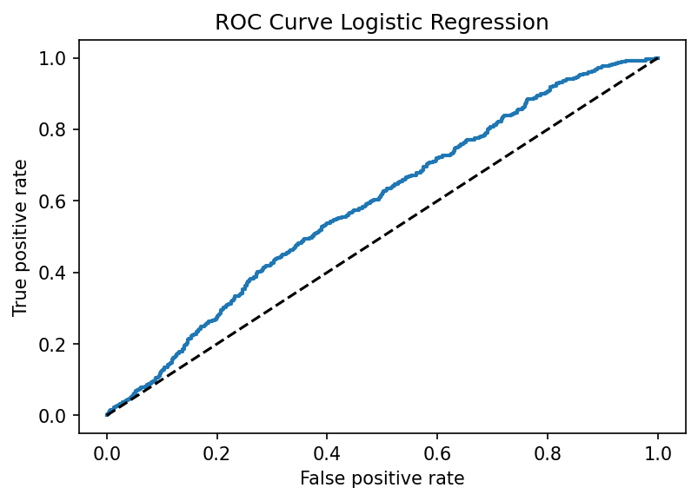
Logistic Regression Results
Threshold = 0.55
F1 Score = 0.509
ROC AUC score = 0.569

Slide 10

Feature Importance Logistic Regression

Slide 11

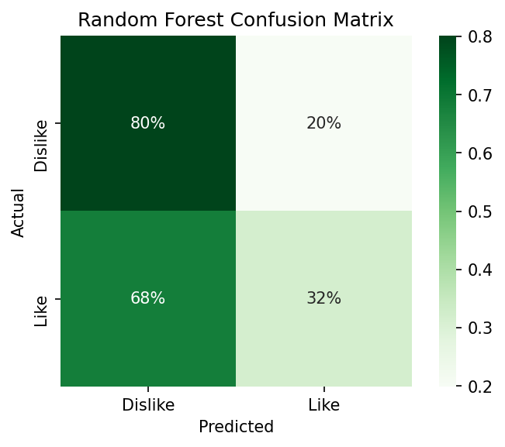
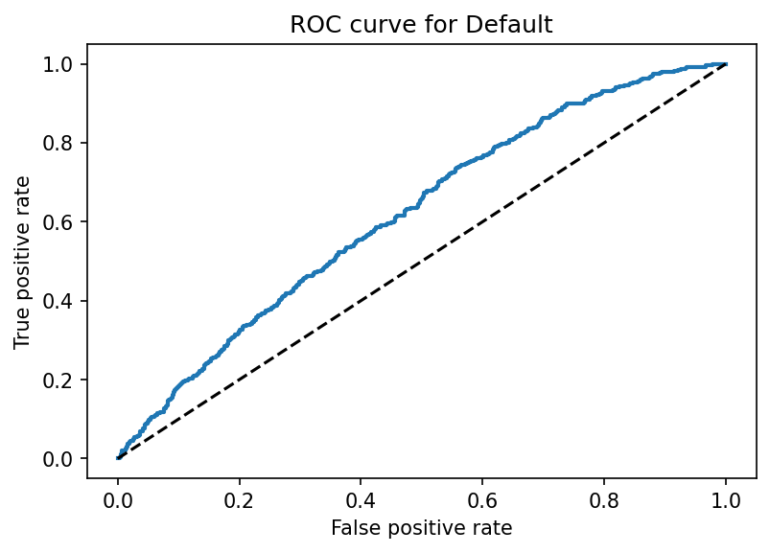
Random Forest Results
Threshold = 0.52
F1 Score = 0.367
ROC AUC score = 0.560

Slide 12
Takeaways

Slide 13

Additional work
Different classification models
More granular data
NLP on lyrics
Song Generation
Waveform decomposition
Spectrogram fingerprinting
Neural Network

Slide 14

Thank you
Lawson Ho
lawsonho@outlook.com
linkedin.com/in/lawsonho

Slide 15




Tools Used
Spotify Web API via Spotipy
Python
Pandas
Sci-kit Learn

